Slide 1

Social Media Suicide Ideation Detection
IT454: Software Development and Project Management
Project Management Team :
1. Syeda Aunanya Mahmud (Team leader)
2. Nazmul Islam
3. Md Zahidul Islam
4. Shihabul Ahmmed
5. Mahmudul Hasan
Batch 45, Department of IT, UITS
Submitted To :
Md. Ishtiaq Iqbal
Lecturer & Course Coordinator,
Department of IT, UITS
23 January, 2023

Slide 2
Contents
Introduction
What We Intend to Do
Purpose
Objective of This Project
About Dataset
What is NLP ?
Data Preprocessing
Algorithm or Model Development: ML & DL models
Future Directives
References
2
23 January, 2023

Slide 3
Introduction
Purpose of This Project
To develop an appropriate ML or DL model to disseminate public health surveillance tools that effectively help finding people who might be in risk of committing suicide.
A possible driver: the exploration of data and textual captured through social media mining.
3
23 January, 2023

Slide 4
Introduction
What We Intend to Do
Twitter-based Suicide Risk Analysis using Machine Learning & Deep Learning models:
Suicide Risk Analysis and Suicide Prediction
Identify the level of negativity within the text of a tweet to detect suicidal risk of an user.
Goal: To attain 80%+ accuracy by implementing the LSTM and BERT models along with the traditional Machine Learning models (Logistic Regression, Multinomial Naive Bayes, SVM, AdaBoost Classifier, GradientBoostingClassifier, and RandomForest Classifier).
4
23 January, 2023

Slide 5
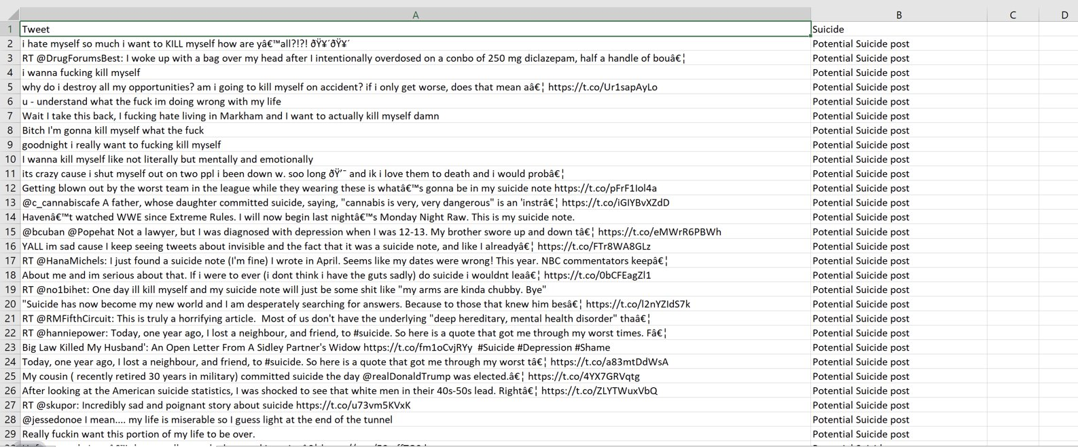
About Dataset
Not Suicidal post 1127​
Potential Suicidal post 660
5
23 January, 2023

Slide 6
Natural language processing
What is Natural language processing (NLP)?
The ability of a computer program to understand and represent human language
A component of Artificial Intelligence (AI).
Suicide Risk Analysis using NLP: Analyze and find the emotion or intent behind a piece of text or speech or any mode of communication.
Methods that help the NLP system to understand text and symbols: text classification, vector semantic, word embedding, probabilistic language model, sequence labeling, and speech reorganization.
Two main phases to NLP: Data Preprocessing and Algorithm Development
6
23 January, 2023

Slide 7
Data Preprocessing
Data cleaning: Filling the missing values
Preprocessing:
Lowercase conversion
Tokenization
Stopwords removing
Language filtering
Lemmetization
Application of N-grams
7
23 January, 2023

Slide 8
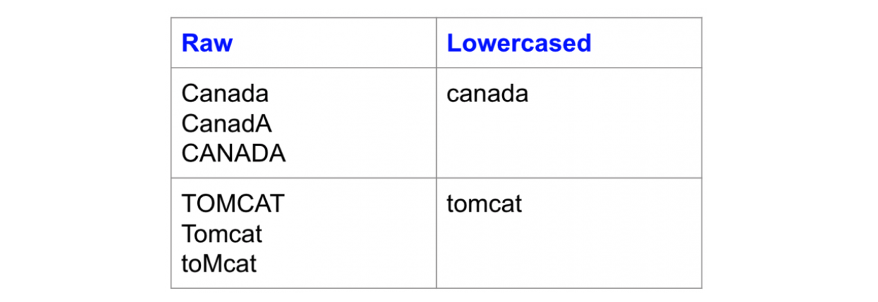
Data Preprocessing
Lowercase conversion
Maintain data consistency and reduce the number of unique words.
Image Source: https://www.kdnuggets.com/2019/04/text-preprocessing-nlp-machine-learning.html
8
23 January, 2023

Slide 9
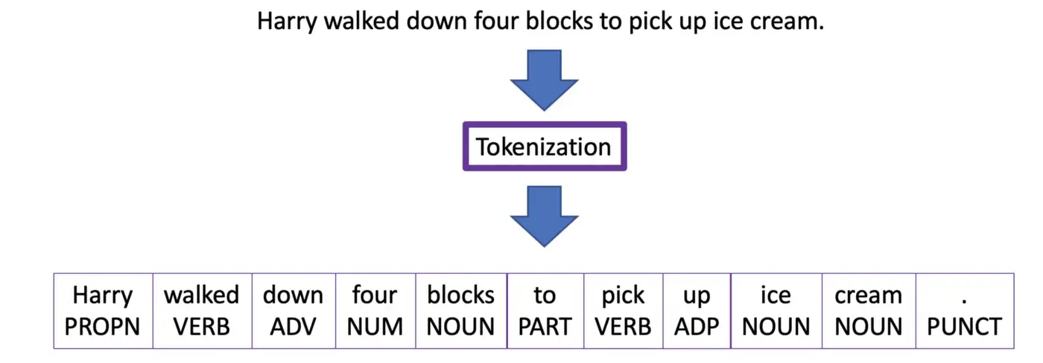
Data Preprocessing
Tokenization
Word tokenization: A sentence would be split into individual words.
Image Source: https://medium.com/@m.derakhshan/tokenization-in-natural-language-processing-86e4e235a2aa
9
23 January, 2023

Slide 10
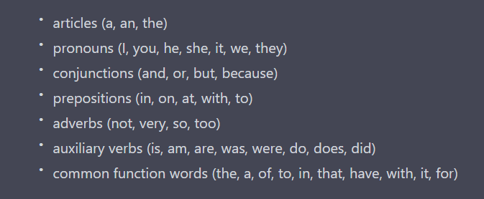
Data Preprocessing
Stopwords Removing
Words that are commonly used in a language but do not provide much meaning or context on their own.
Stopword list include:
10
23 January, 2023

Slide 11
Data Preprocessing
Language Filtering
Filter out non-English words from a dataset.
Creates a set of words from three corpora of English texts:
Reuters Corpus: Contains over 800,000 documents and over 1.3 million words.
Brown Corpus: Contains over 60,000 books.
Gutenberg Corpus: Contains over 1 million words.
11
23 January, 2023

Slide 12
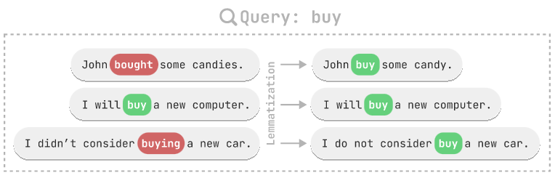
Data Preprocessing
Lemmetization
Uses a dictionary to map words to their base form.
Image Source: https://explosion.ai/blog/edit-tree-lemmatizer
12
23 January, 2023

Slide 13
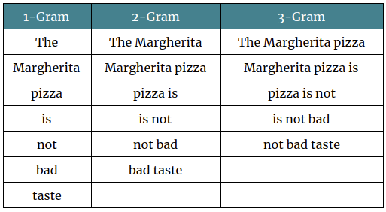
Data Preprocessing
Application of N-grams
Extract features that capture the context and meaning of the text.
N-gram sizes: Unigrams (n = 1), Bigrams (n = 2), Trigrams (n = 3), etc.
Text = “The Margherita pizza is not bad taste”:
Image Source: https://studymachinelearning.com/an-introduction-to-n-grams/
13
23 January, 2023

Slide 14
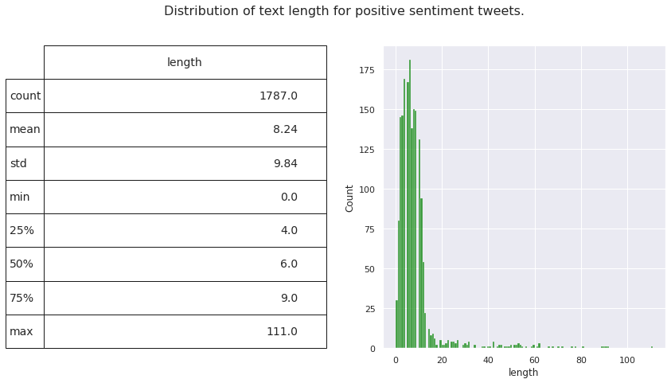
Data Visualization
Table in a matplotlib axis with its customized appearance and seaborn's histplot:
14
23 January, 2023

Slide 15
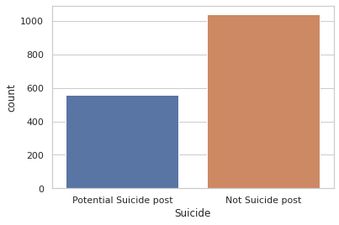
Data Visualization
Bar chart to visualize the count of a categorical variable using the Seaborn library:
15
23 January, 2023

Slide 16
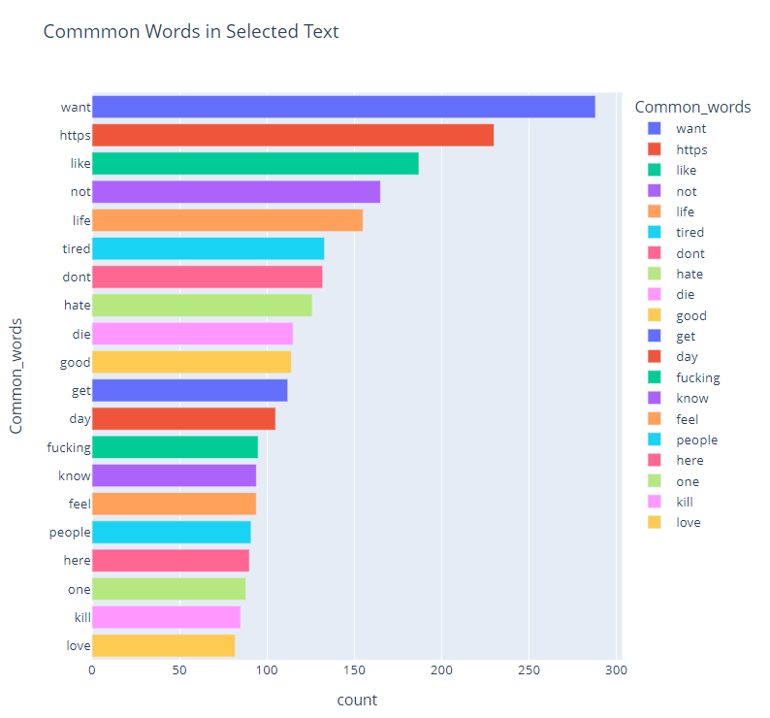
Data Visualization
Bar chart using the Plotly Express library for entire dataset:
16
23 January, 2023

Slide 17
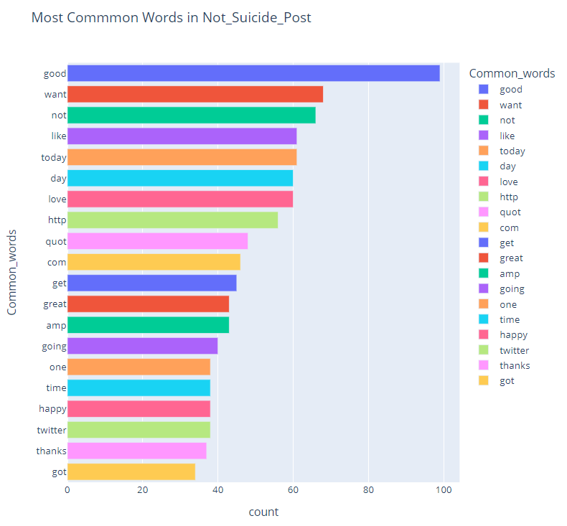
Data Visualization
Bar chart using the Plotly Express library for "Not_Suicide_Post" column:
17
23 January, 2023

Slide 18
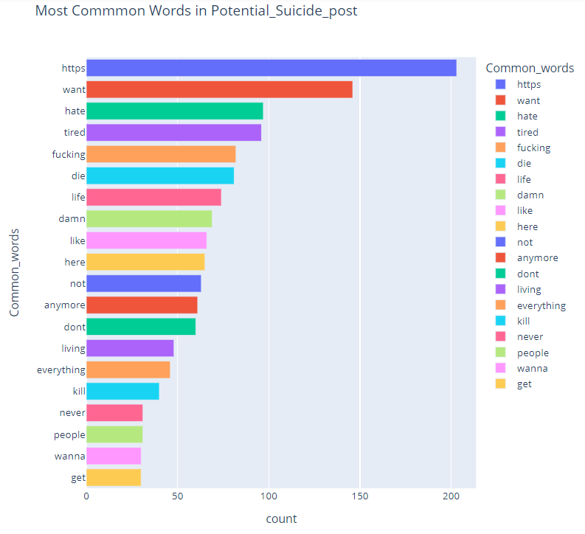
Data Visualization
Bar chart using the Plotly Express library for "Potential_Suicide_Post" column:
18
23 January, 2023

Slide 19
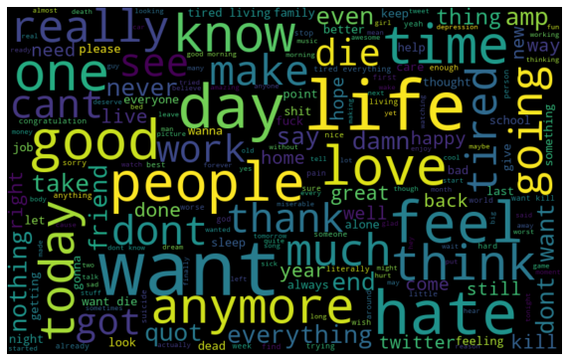
Data Visualization
Word cloud to visualize most frequent words in entire dataset:
19
23 January, 2023

Slide 20
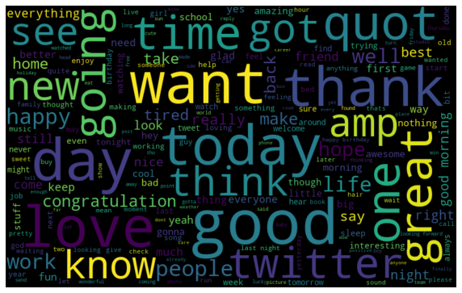
Data Visualization
Word cloud to visualize most frequent words in "Not_Suicide_Post" column:
20
23 January, 2023

Slide 21
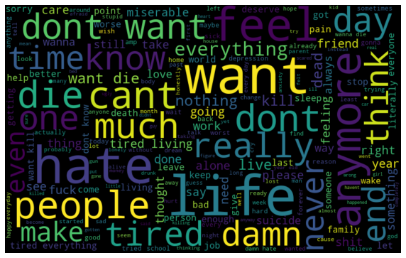
Data Visualization
Word cloud to visualize most frequent words in "Potential_Suicide_Post" column:
21
23 January, 2023

Slide 22
Machine Learning Models
Logistic Regression Model
A statistical method for predicting binary outcomes from a set of predictor variables.
Creates a relationship between the predictor variables and the binary outcome using a logistic function
Outputs a probability value between 0 and 1 :
Value of 0: Suicide risk.
Value of 1: No suicide risk.
Why use LR Model?
Handles both linear and non-linear relationships, high-dimensional data and large datasets.
Computationally efficient and interpretability.
22
23 January, 2023

Slide 23
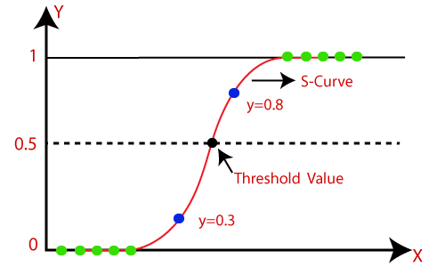
Machine Learning Models
Logistic Regression Model
Fig: Working principle of Logistic Regression
Image Source: https://www.javatpoint.com/logistic-regression-in-machine-learning
23 January, 2023
23

Slide 24
Machine Learning Models
Support Vector Machine
Finds a hyperplane that maximizes the margin to separate the different classes in the data set.
Assigns a weight to each word to determine the importance of each word for text classification.
Why use SVM Model?
Handles non-linearly separable and high-dimensional data by using the kernel trick.
Provides a way to handle imbalanced datasets.
24
23 January, 2023

Slide 25
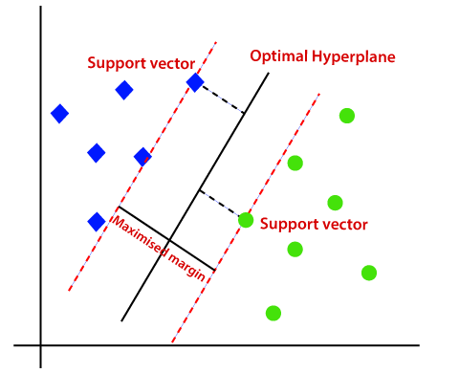
Machine Learning Models
Support Vector Machine
Fig: Working principle of SVM
Image Source: https://www.javatpoint.com/machine-learning-support-vector-machine-algorithm
25
23 January, 2023

Slide 26
Machine Learning Models
Multinomial Naive Bayes
A type of probabilistic model and a variant of the traditional Naive Bayes algorithm.
Makes the naive assumption that all the features in the data are independent of each other.
Uses the relative frequency of each feature in the training data to estimate the probability of each class.
Why use MNB Model?
Particularly suited for discrete data.
Handles high-dimensional, imbalanced and large datasets.
26
23 January, 2023

Slide 27
Machine Learning Models
Random Forest Model
A type of ensemble learning method.
Trains multiple decision trees on subsets of the data.
Combines the predictions of multiple decision trees.
Why use RF Model?
Handles high-dimensional and non-linearly separable data by averaging the predictions of multiple decision trees.
Handles overfitting.
Provides feature importance.
27
23 January, 2023

Slide 28
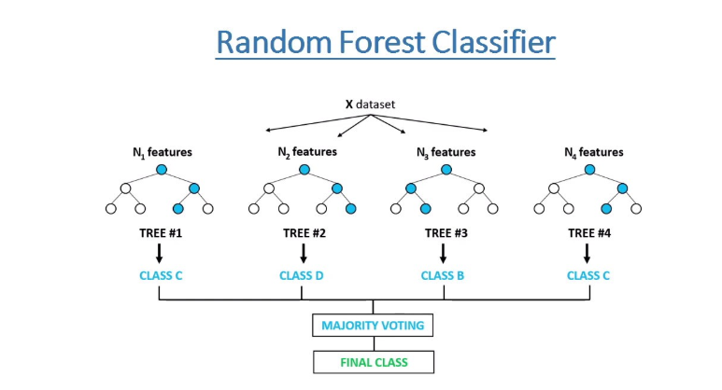
Machine Learning Models
Random Forest Classifier
Fig: Working principle of Random Forest Classifier
Image Source: https://www.freecodecamp.org/news/how-to-use-the-tree-based-algorithm-for-machine-learning/
23 January, 2023
28

Slide 29
Machine Learning Models
Gradient Boosting Classifier
Trains a sequence of simple models, such as decision trees, in a step-by-step manner.
Each model is trained to correct the errors of the previous model in the sequence.
Why use GBC Model?
Handles high-dimensional and non-linearly separable data by using a combination of weak models (such as decision trees) and adjusting their weights.
Handles overfitting.
Provides feature importance.
29
23 January, 2023

Slide 30
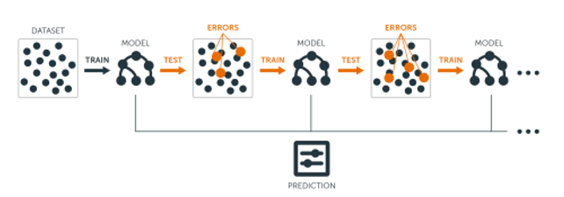
Machine Learning Models
Gradient Boost Classifier
Fig: Working principle of Gradient Boost Classifier
Image Source: https://www.analyticsvidhya.com/blog/2020/10/adaboost-and-gradient-boost/
30
23 January, 2023

Slide 31
Machine Learning Models
Ensemble Classifier
Stacking ensemble.
Trains a meta-model to make a final prediction based on the predictions of the base models.
Why use Ensemble Classifier?
Handles high-dimensional and non-linearly separable data by using the strengths of different models.
Handles overfitting.
Provides feature importance.
31
23 January, 2023

Slide 32
Machine Learning Models
AdaBoost with Random Forest Classifier Model
Combines two different ensemble methods: AdaBoost and Random Forest.
Uses RF Classifier: Trains multiple decision trees on random subsets of the data.
Uses AdaBoost Classifier:
Adjust the weights of the data points,
Combine the predictions of the individual Random Forest classifiers.
Why use ABRF Model?
Handles high-dimensional, non-linearly separable and large datasets.
Handles overfitting.
Provides feature importance.
32
23 January, 2023

Slide 33
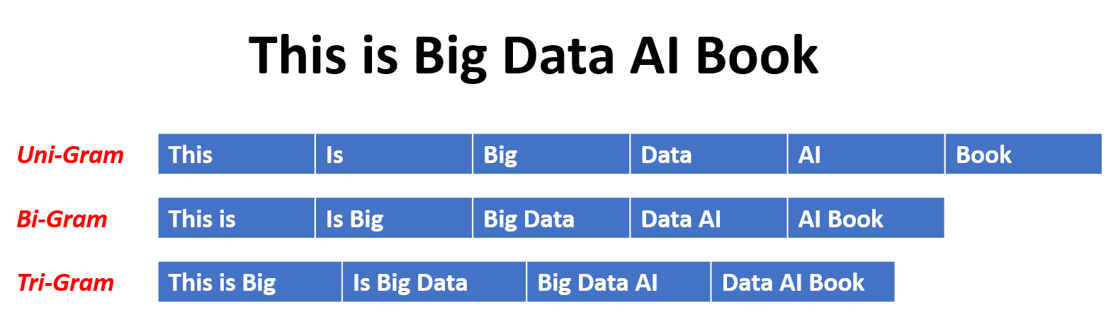
Machine Learning Models
N-grams
Image Source : https://devopedia.org/n-gram-model
33
23 January, 2023

Slide 34
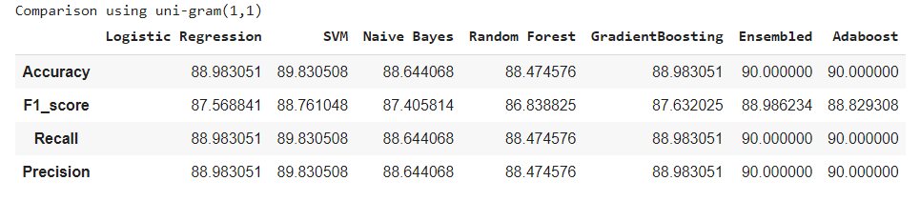
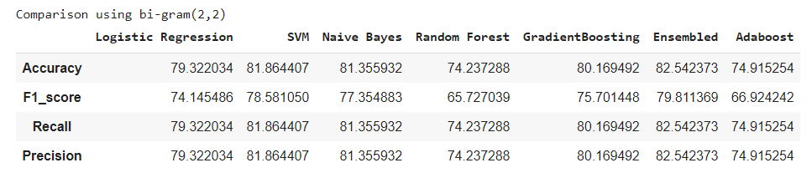
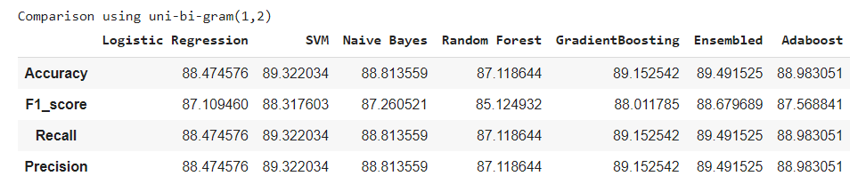
Machine Learning Models Comparison Between ML Models
34
23 January, 2023

Slide 35
Deep Learning Models
Bidirectional Long Short-Term Memory(LSTM) Model
Bidirectional-LSTM: Variant of RNN that processes input in both forward and backward directions, considering past and future context.
Two LSTM Networks: Forward and Backward direction input sequence processing.
Can use multiple layers of LSTM:
LSTM 1-layer: Single layer captures long-term dependencies
LSTM 2-layers: Two layers captures initial and higher-level features.
35
23 January, 2023

Slide 36
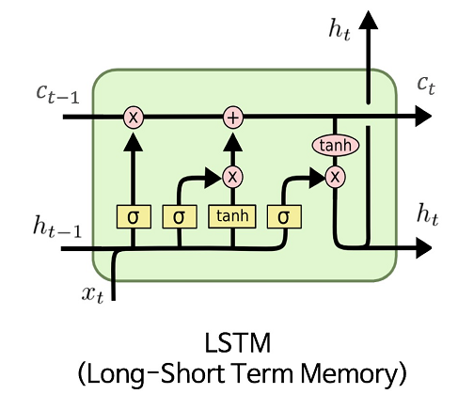
Deep Learning Models
LSTM Cell :
Image Source: https://towardsdatascience.com/lstm-gradients-b3996e6a0296
36
23 January, 2023

Slide 37
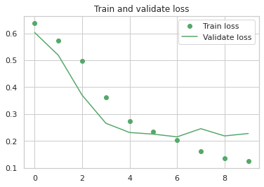
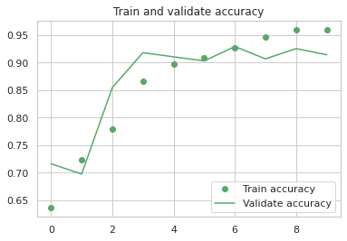
Deep Learning Models
Accuracy: 93.95973086357117%
Visualization of training and validation loss and accuracy for LSTM 1-Layer model:
37
23 January, 2023

Slide 38
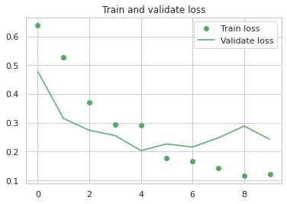
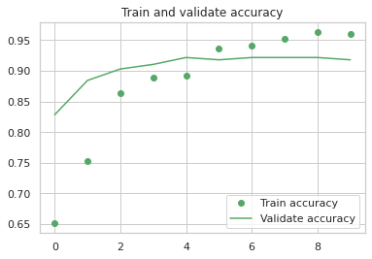
Deep Learning Models
Accuracy: 94.18344497680664%
Visualization of training and validation loss and accuracy for LSTM 2-Layer model:
38
23 January, 2023

Slide 39
Deep Learning Models
Why use Bidirectional LSTM Model?
Bidirectional LSTMs handle sequential data and long-term dependencies
Improve performance in tasks such as NLP, speech recognition, and time series prediction
Handle missing or incomplete data and noise better than unidirectional LSTMs.
39
23 January, 2023

Slide 40
Deep Learning Models
Gated Recurrent Unit(GRU) Model
GRU: RNN with fewer parameters, handles sequential data and captures long-term dependencies
Two gates: reset and update, controlling information preservation/discarding
Output is a combination of previous state and new input, controlled by gates.
40
23 January, 2023

Slide 41
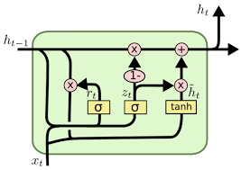
Deep Learning Models
GRU Cell:
Image Source: http://primo.ai/index.php?title=Gated_Recurrent_Unit_%28GRU%29
41
23 January, 2023

Slide 42
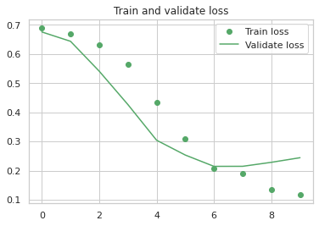
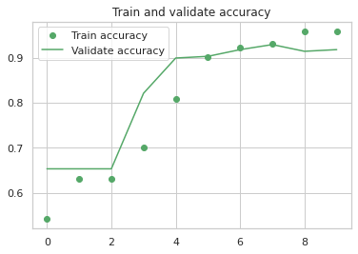
Deep Learning Models
Accuracy: 92.84116625785828%
Visualization of training and validation accuracy and loss for GRU model:
42
23 January, 2023

Slide 43
Deep Learning Models
Why use GRU Model?
GRUs: Fewer parameters, efficient, less prone to overfitting, handle sequential data, dependencies, missing or incomplete data and noise better.
GRUs performance is comparable or better than LSTMs, especially in NLP and speech recognition
GRUs are faster to train than LSTMs.
43
23 January, 2023

Slide 44
Deep Learning Models
Convolutional Neural Network(CNN)+LSTM Model
Convolutional models: Use convolutional layers to process sequential data.
Convolutional layer: Applies filters to input data, creates feature maps, captures local patterns in data.
LSTM: Processes the feature maps from the output of convolutional layers, making predictions.
Combination of two architectures learn both spatial and temporal features from the input data.
44
23 January, 2023

Slide 45
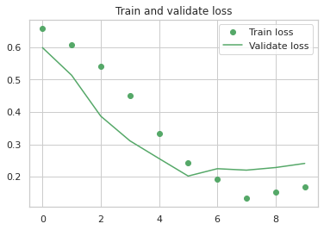
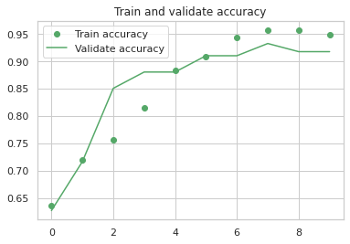
Deep Learning Models
Accuracy: 93.51230263710022%
Visualization of training and validation accuracy and loss for CNN+LSTM model:
45
23 January, 2023

Slide 46
Deep Learning Models
Why use CNN+LSTM Model?
CNN's ability to extract features from the input text, and LSTM's ability to learn temporal dependencies and long-term context in the text.
Ability to learn both local and global features and can handle sequential data.
46
23 January, 2023

Slide 47
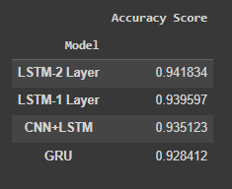
Deep Learning Models Comparison Between DL Models
Accuracy comparison:
47
23 January, 2023

Slide 48
Deep Learning Models
Bidirectional Encoding Representation For Transformers(BERT) Model
BERT: pre-trained transformer-based model for NLP tasks, fine-tune on various tasks like text classification, named entity recognition, question answering.
"Bidirectional" processing: considers context from both directions for better understanding of words.
Pre-trained on large corpus, fine-tune on small task-specific data.
BERT is pre-trained on two different, but related, NLP task:
Masked Language Modeling: predict hidden word based on context
Next Sentence Prediction: predict logical connection between sentences.
48
23 January, 2023

Slide 49
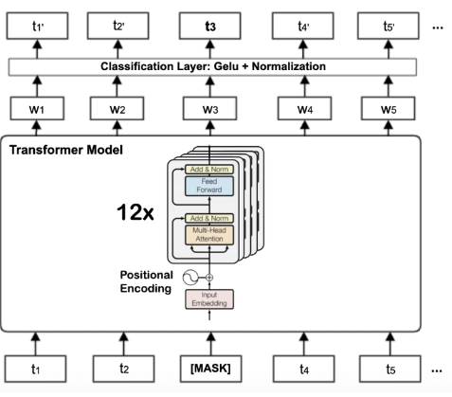
Deep Learning Models
BERT Model :
Image Source: https://www.researchgate.net/figure/The-Transformer-based-BERT-base-architecture-with-twelve-encoder-blocks_fig2_349546860
49
23 January, 2023

Slide 50
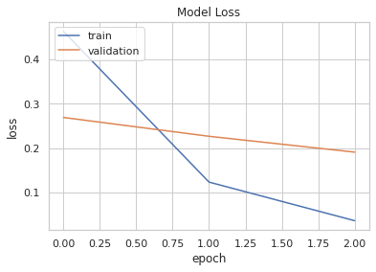
Deep Learning Models
Visualization of training and validation loss for BERT model:
50
23 January, 2023

Slide 51
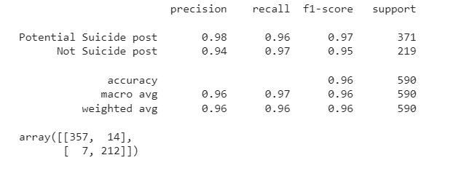
Deep Learning Models
Classification report and confusion matrix of BERT model:
51
23 January, 2023

Slide 52
Deep Learning Models
Why use BERT?
Bidirectional context: understands meaning of words in a nuanced way
Pre-training: can be fine-tuned on specific NLP tasks with small task-specific data
State-of-the-art performance on NLP tasks
Transfer learning: fine-tune on various tasks with lack of labeled data
Multilingual: pre-trained on multilingual corpus, improve performance on non-English tasks
BERT is open-source.
52
23 January, 2023

Slide 53
Future Directives
Implementation of XLNet model and Active Learning approach.
Multitask learning
Multilingual model
Incorporating other types of data into the analysis: Images, Videos, or Audio
53
23 January, 2023

Slide 54
References
[1] M. M. T. Liang Yang, “Detection of Suicide Ideation in Social Media Forums Using Deep Learning,” 2019. [Online]. Available: https://www.mdpi.com/1999-4893/13/1/7
[2] S. V. Rina Dutta 2,3*, “Risk Assessment Tools and Data-Driven Approaches for Predicting and Preventing Suicidal Behavior,” 2019. [Online]. Available: https://www.frontiersin.org/articles/10.3389/fpsyt.2019.00036/full
[3] R. S. Rajiv Ratn Shah, “Robust suicide risk assessment on social media via deep adversarial learning,” 2021. [Online]. Available: https://pubmed.ncbi.nlm.nih.gov/33779728/
54
23 January, 2023

Slide 55
Thank You
If you have questions, please feel free to ask.
55
23 January, 2023

